Slide 1

SAP BTP ABAP on Cloud / RAP Training
DAY-6
Anubhav Oberoy
www.AnubhavTrainings.com
Follow excellence with sheer passion

Slide 2


DISCLAIMER
The training content and delivery of this presentation is confidential, and cannot be recorded, or copied and distributed to any third party, without the written consent of Anubhav Trainings

Slide 3

01
Adding UI Elements
02
Enhance Object Page
03
Create multiple level drill down
04
Adding BDEF
Notes:
https://pixabay.com/photos/san-francisco-transamerica-pyramid-1633203/

Slide 4
Managed RAP implementation
The managed RAP implementation addresses use cases where all the essential parts of the applications are to be developed from scratch. However, these new applications can highly benefit from out-of-box support for transactional processing. Standard operations like create, update, delete must only be specified in the behavior definition to obtain a ready-to-run business object. The provisioning of transaction buffer is also done automatically for us by the framework. The interaction phase and save sequence are also implemented generically. The application developer can focus on business part of app like adding custom validation, actions, determinations. The RAP transaction engine manages the life cycle of our Business object and covers all the aspects of our app development.
The managed implementation type is aimed for building new applications from scratch without having any prior coding exist. The standard functionality that given in managed business objects is easily retrieved. The business logic implemented using predefined implementation methods that are integrated during the runtime in the interaction phase and save sequence.
www.anubhavtrainings.com

Slide 5



Business use case
We will implementing 2 different applications on travel data model. These applications will target different user groups. We will manage the travel requests and booking through our applications which are booked by agency for customer.
Processor – a processor is an employee of our company who will request a new travel plan through the application. He/she will be allowed to create, update, delete, copy travel requests including bookings and supplements. They have full control to manage their travel.
Approver – an approver is a manager who will only be able to view the travel requests created by employees, and can only change the booking fees and approval status of the request (approve/reject).
MakeMyTrip.com- processor app
Processor needs to create, update, delete a travel request through agency including all bookings and supplements
Approval App
The manager would review the travel requests created by processor, can only change the booking fees and approve or reject the travel request
www.anubhavtrainings.com

Slide 6
Understanding projection
If we ever get requirement in our company to develop a use case where we want to reuse the data model (e.g. sales, purchase, accounting, finance) but develop many applications. We will go with RAP and projections. A projection takes part of the base functionality according the needs to user. This will reduce effort, increase reusability in our app.
www.anubhavtrainings.com

Slide 7
Business Object Definition
From structural point of view, a business object consists of a tree of entities (cds) that are linked in compositions. Every entity in this composition tree is an element that is modeled with CDS view entities. For our demo travel scenario we will implement 3 level composition tree.
/dmo/travel_m
(root entity)
1..N
Business Object
/dmo/booking_m
(child entity)
1..N
/dmo/bookingsuppl_m
(child entity)
www.anubhavtrainings.com

Slide 8
Understanding projection
If we ever get requirement in our company to develop a use case where we want to reuse the data model (e.g. sales, purchase, accounting, finance) but develop many applications. We will go with RAP and projections. A projection takes part of the base functionality according the needs to user. This will reduce effort, increase reusability in our app.
www.anubhavtrainings.com

Slide 9

Development Flow – Processor and Approver
Fiori App – Processor
Create, update, delete, copy travel
Fiori App – Approver
Display the travel request data
Service definition
Service Binding
Service definition
Service Binding
MDE for Processor Projection
MDE for approver Projection
BDEF Projection
For Processor
Expose what is needed by a processor role in company
Behavior Definition (BDEF)
Tell RAP framework regarding our operations which needs to be supported for BO (managed)
BDEF Projection
For Approver
Expose what is needed by a approver role in company
Business Object Projection
For Processor
30 fields to internet
Business Object (definition)
Includes the Travel, Booking and Booking Supplement CDS entities
100 fields
Business Object Projection
For Approver
25 fields
www.anubhavtrainings.com

Slide 10
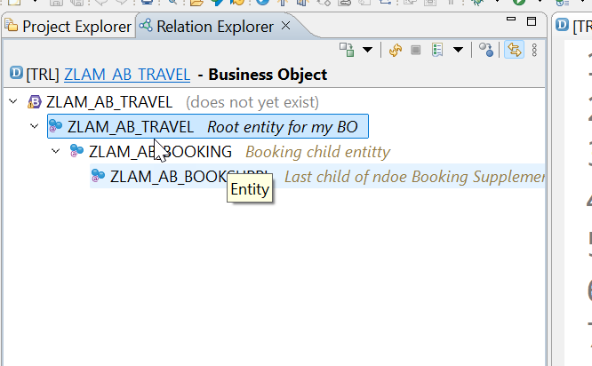
Business Object Definition
From structural point of view, a business object consists of a tree of entities (cds) that are linked in compositions. Every entity in this composition tree is an element that is modeled with CDS view entities. For our demo travel scenario we will implement 3 level composition tree.
/dmo/travel_m
(root entity)
1..N
Business Object
/dmo/booking_m
(child entity)
1..N
/dmo/bookingsuppl_m
(child entity)
www.anubhavtrainings.com

Slide 11
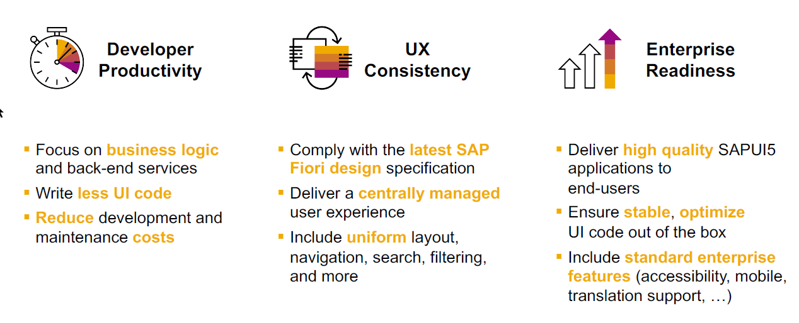
SAP Fiori elements boosts SAP Fiori development efficiency
www.anubhavtrainings.com

Slide 12
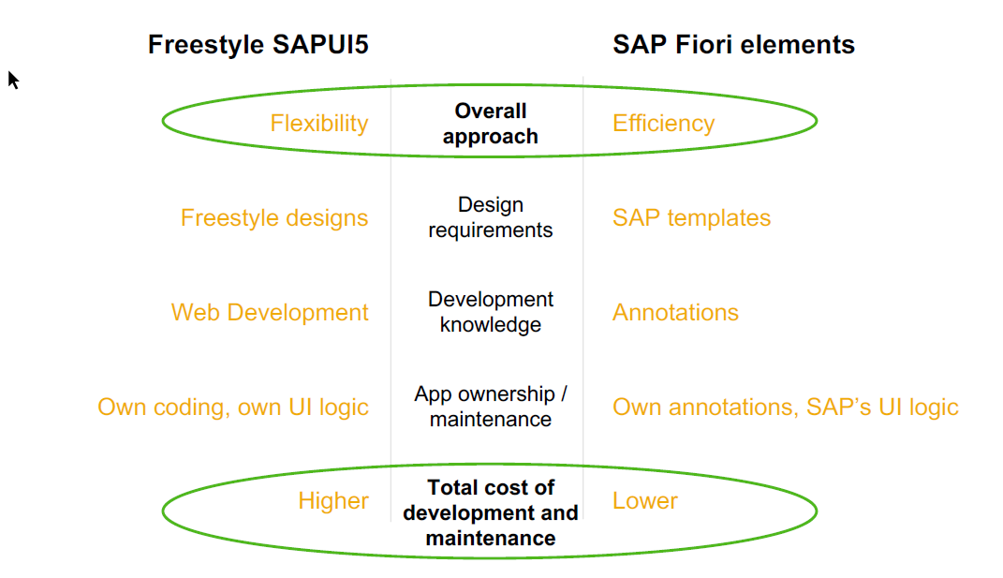
SAP Fiori elements prioritizes efficiency over flexibility
www.anubhavtrainings.com

Slide 13


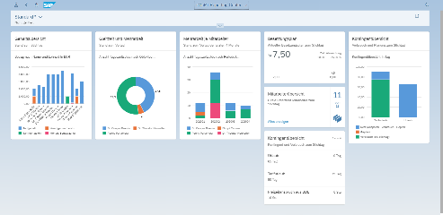





Developer Persona – Fiori Elements
Anubhav
Happy User
Rob
S/4HANA Technical consultant
ABAP Developer
Roxana
UX Designer | Fiori Developer
ABAP Dev. Tools
On
Eclipse
VS Code
BAS
OData Service
Fiori Elements Project
Annotations.xml
CDS Views
MDE
@
www.anubhavtrainings.com

Slide 14
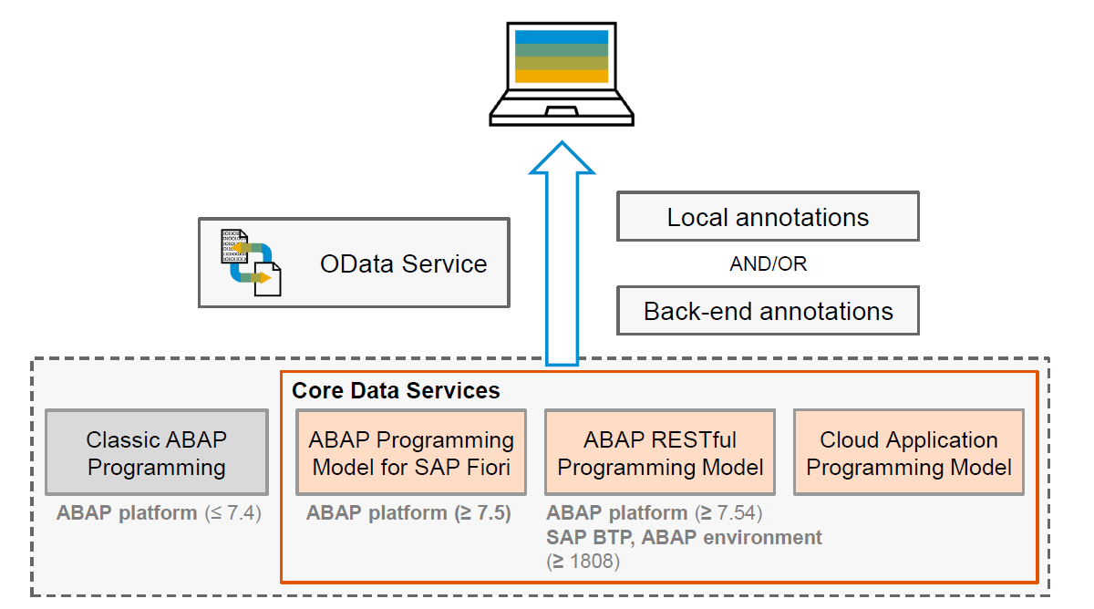
Big Picture – Architecture
www.anubhavtrainings.com

Slide 15
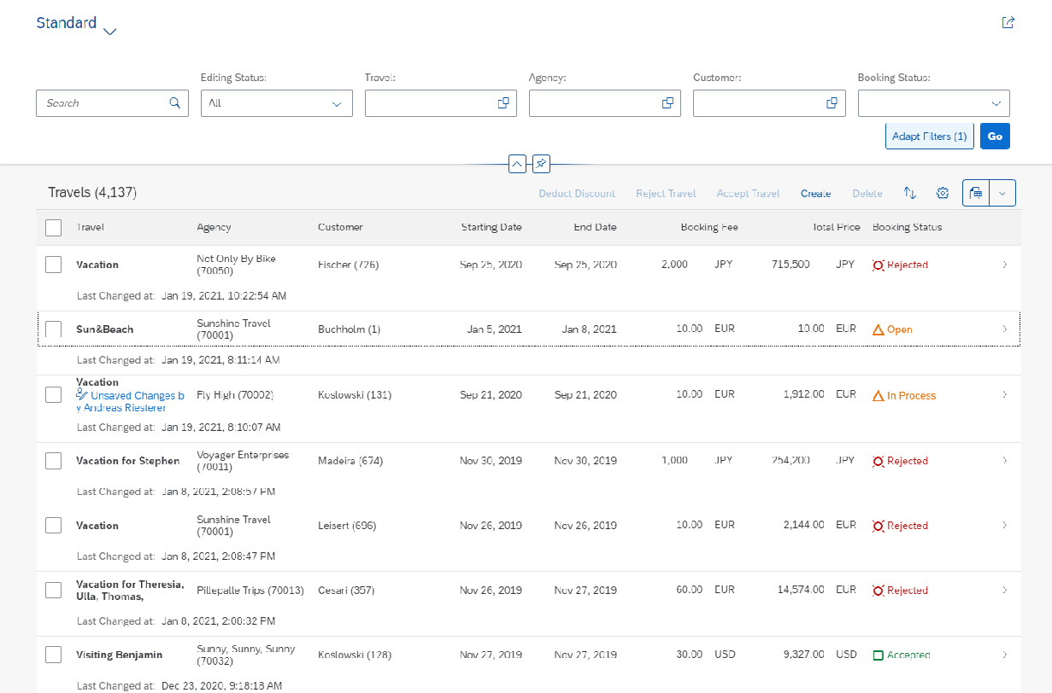
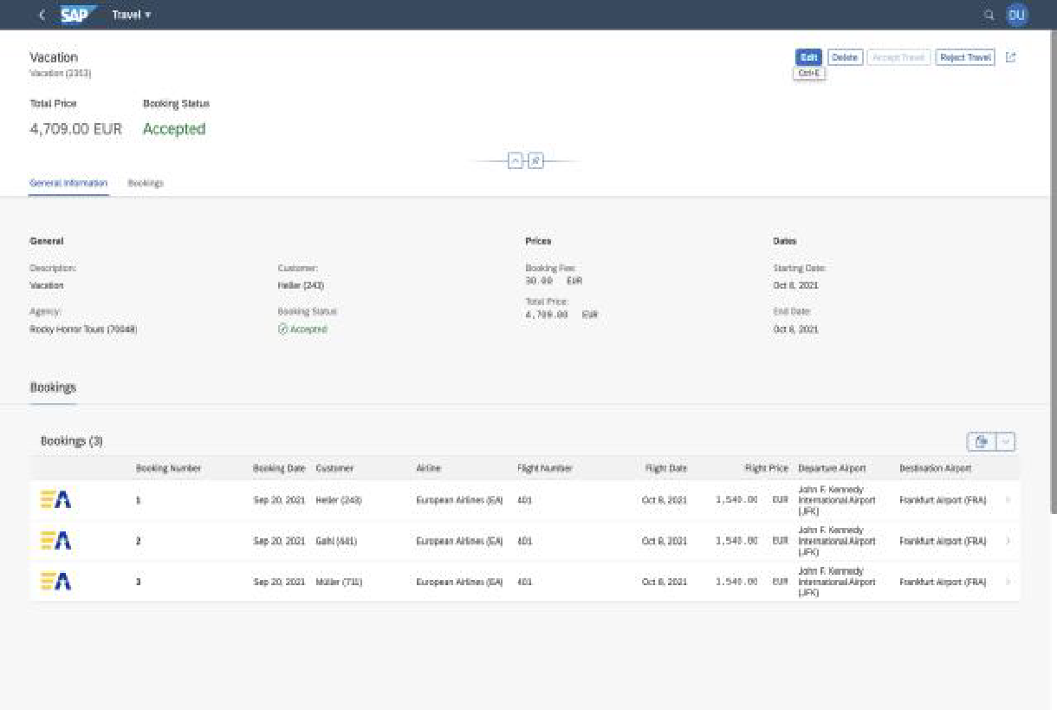
Fiori Elements - List Report Application
The list report offers powerful features for finding and acting on relevant data sets. It is often used as an entry point for navigating to the item details, which are usually shown on an object page.
List Report
Object Page
www.anubhavtrainings.com

Slide 16
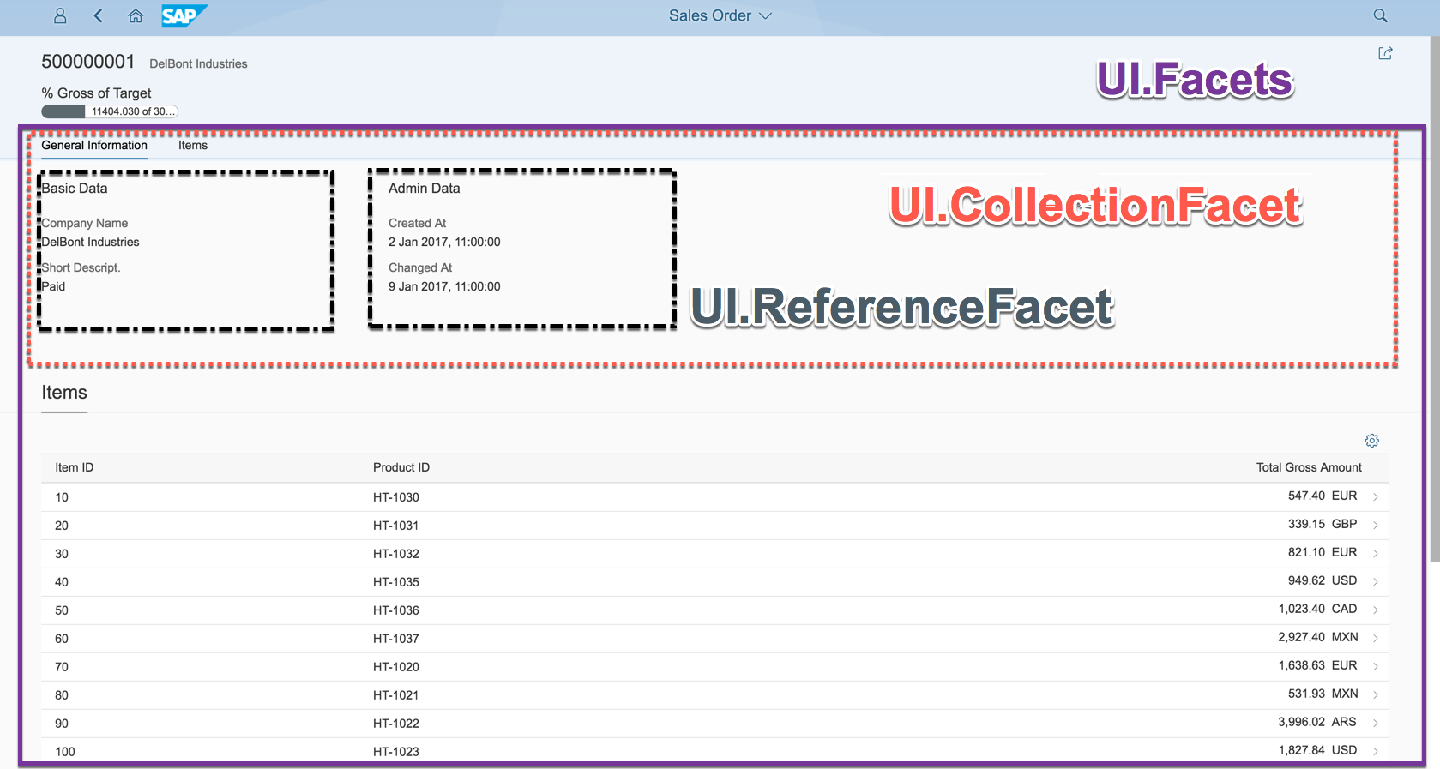
Object Page
www.anubhavtrainings.com

Slide 17
Fiori Elements - List Report Application
The list report offers powerful features for finding and acting on relevant data sets. It is often used as an entry point for navigating to the item details, which are usually shown on an object page.
List Report
Object Page
www.anubhavtrainings.com

Slide 18
Object Page
www.anubhavtrainings.com

Slide 19
Annotation Documentation
https://help.sap.com/doc/saphelp_nw75/7.5.5/en-US/63/0ce9b386b84e80bfade96779fbaeec/content.htm?no_cache=true
https://ui5.sap.com/#/topic/1cf5c7f5b81c4cb3ba98fd14314d4504
@UI.SelectionField – Create filter fields on screen 1 (List Report)
@UI.LineItem – Create Columns on first Screen (Table area on list report)
@UI.HeaderInfo – Provide title to the table and arrange header for the object page (second screen)
@UI.Facets – To create tabs on the object page
@UI.Identification – can only be one, Configure default fields on object page (inside facet)
@UI.FieldGroup – To create field groups (group of fields) in a block with label and text
@UI.datapoint – to create a single value to be displayed in a chart or on top of page
@UI.Chart – to create a chart with a particular chart type
www.anubhavtrainings.com

Slide 20
Behavior Definition (BDEF)
Behavior definition describes the behavior of the business object in terms of what operations are allowed for our entire BO. If the BO consists of multiple entities (e.g. Travel, Booking, Booking Suppl), there is exactly one BDEF which exist for this business object.
The BDEF will have exactly same name as your root entity, you are not allowed to change the name. We can test our business object once the behavior definition is created. The RAP framework will auto generate all the necessary code behind the scenes to handle the CURD (Create, Update, Read, and Delete) operations on our BO.
Based on the BDEF, the RAP framework will decide whether it’s a managed or unmanaged scenario. In addition to CURD, we can also maintain the actions, determinations, prechecks, validations, draft availability, draft actions etc. as part of behaviour definition.
The name of BDEF is always same name as your BO.
https://help.sap.com/docs/ABAP_PLATFORM_NEW/fc4c71aa50014fd1b43721701471913d/761d389302e8463a9c3509907f22f22f.html?q=behavior%20definition#loio761d389302e8463a9c3509907f22f22f__impl_strict_transAct
Business Object
Travel(root)+Booking+Booking Suppl
Behaviour Definition
1 0..1
www.anubhavtrainings.com

Slide 21
Framework Generated IDs
The RAP framework will contain multiple framework generated values when data comes to us in our ABAP code or when we process the BO instance. All the framework generated parameters starts with %
%CID
During create mode the primary key of BO instance is not generated, until the save sequence is execute (like late numbering) like in our case the travel id is created after all the validations are passed. We have %CID also known as content id and is used in the OData request to bind the result operation to a name so that it can be referenced in another operation later. I sent a call from my laptop, one of the browser session, so if there is a issue, I only should get the error on my screen.
It is like a temporary primary key which is given by the RAP framework kept in the transaction buffer to track the user session or our BO instance. Later on once the actual key is generated, the %CID will act like a foreign key to associate with session and will sent back to RAP by us to inform RAP that which session does this operation belongs to.
%tkey
When we apply operations on our table like a action. We also receive a table key in our code, and based on that we will reply the RAP that a particular operation on the table was completed. If something goes wrong we will also inform the error to the RAP framework using this table key.
%key
For a single operation like Edit, Delete inside the object page, we will also receive the key of the object which we are editing or deleting.
www.anubhavtrainings.com

Slide 22
EML – Entity Manipulation Language
The EML is part of ABAP language that access to RAP BO. Because the consumption of business object via odata protocol requires a Fiori UI or Web API, the EML enables a type-safe access to business object directly. EML interacts with the business object entities (single entity – travel) to perform all the entity operations.
EML can be used to provide behaviour for business object. For example, we can implement an action that first triggers a create and then a update using the EML. It is one of the best way to consume our RAP framework and Business object using plain ABAP code w/o creating any special API or service.
Use cases:
Consumption of RAP functionality in Plain ABAP
Testing purpose
Build special business logic
Generate test data
For integration with classic code
www.anubhavtrainings.com

Slide 23
Syntax for EML
Read operation
Read from Root entity and by the key
Read the root entity with its composition child (travel and booking together)
A read operation always either returns a RESULT 🡺 capture in a internal table
OR returns an error table called as FAILED 🡺 capture in a internal table
AND returns an table of messages as REPORTED 🡺 capture in a internal table (other messages)
If we use second option we can specify the associated entity using \_AssociationName
READ ENTITIES OF RootEntityName
ENTITY EntityAlias FROM keys ---(primary key value)
RESULT lt_result
BY \_Composition FROM child_keys
RESULT lt_result_child
FAILED lt_failed
REPORTED lt_reported.
www.anubhavtrainings.com

Slide 24
Update and Delete operations
MODIFY ENTITY OF EntityName AS alias_name
ENTITY EntityName
CREATE FROM lt_create
UPDATE FROM lt_update
DELETE FROM lt_delete
CREATE BY \_AssociationName FROM lt_instance_cba
RESULT lt_result
FAILED lt_failed
REPORTED lt_messages
MAPPED lt_mapped.
www.anubhavtrainings.com

Slide 25
www.anubhavtrainings.com
Thank You
End of Day 6
www.anubhavtrainings.com

Slide 26


We’re committed to empower you to be
#FutureReady
through powerful training solutions.
We build the workforce of the future.
250+
Corporate Clients
30,000+
Learners Trained
25000+
Learners Placed
FREE WEBINARS
Sign up for free webinars with industry experts every fortnight!
Enroll Now!
Contact us today!
https://anubhavtrainings.com

